Slide 1

Customer Shopping Behavior Analysis
3,900 purchases | 18 features | Goal: spending patterns, segments, product & subscription insights

Slide 2
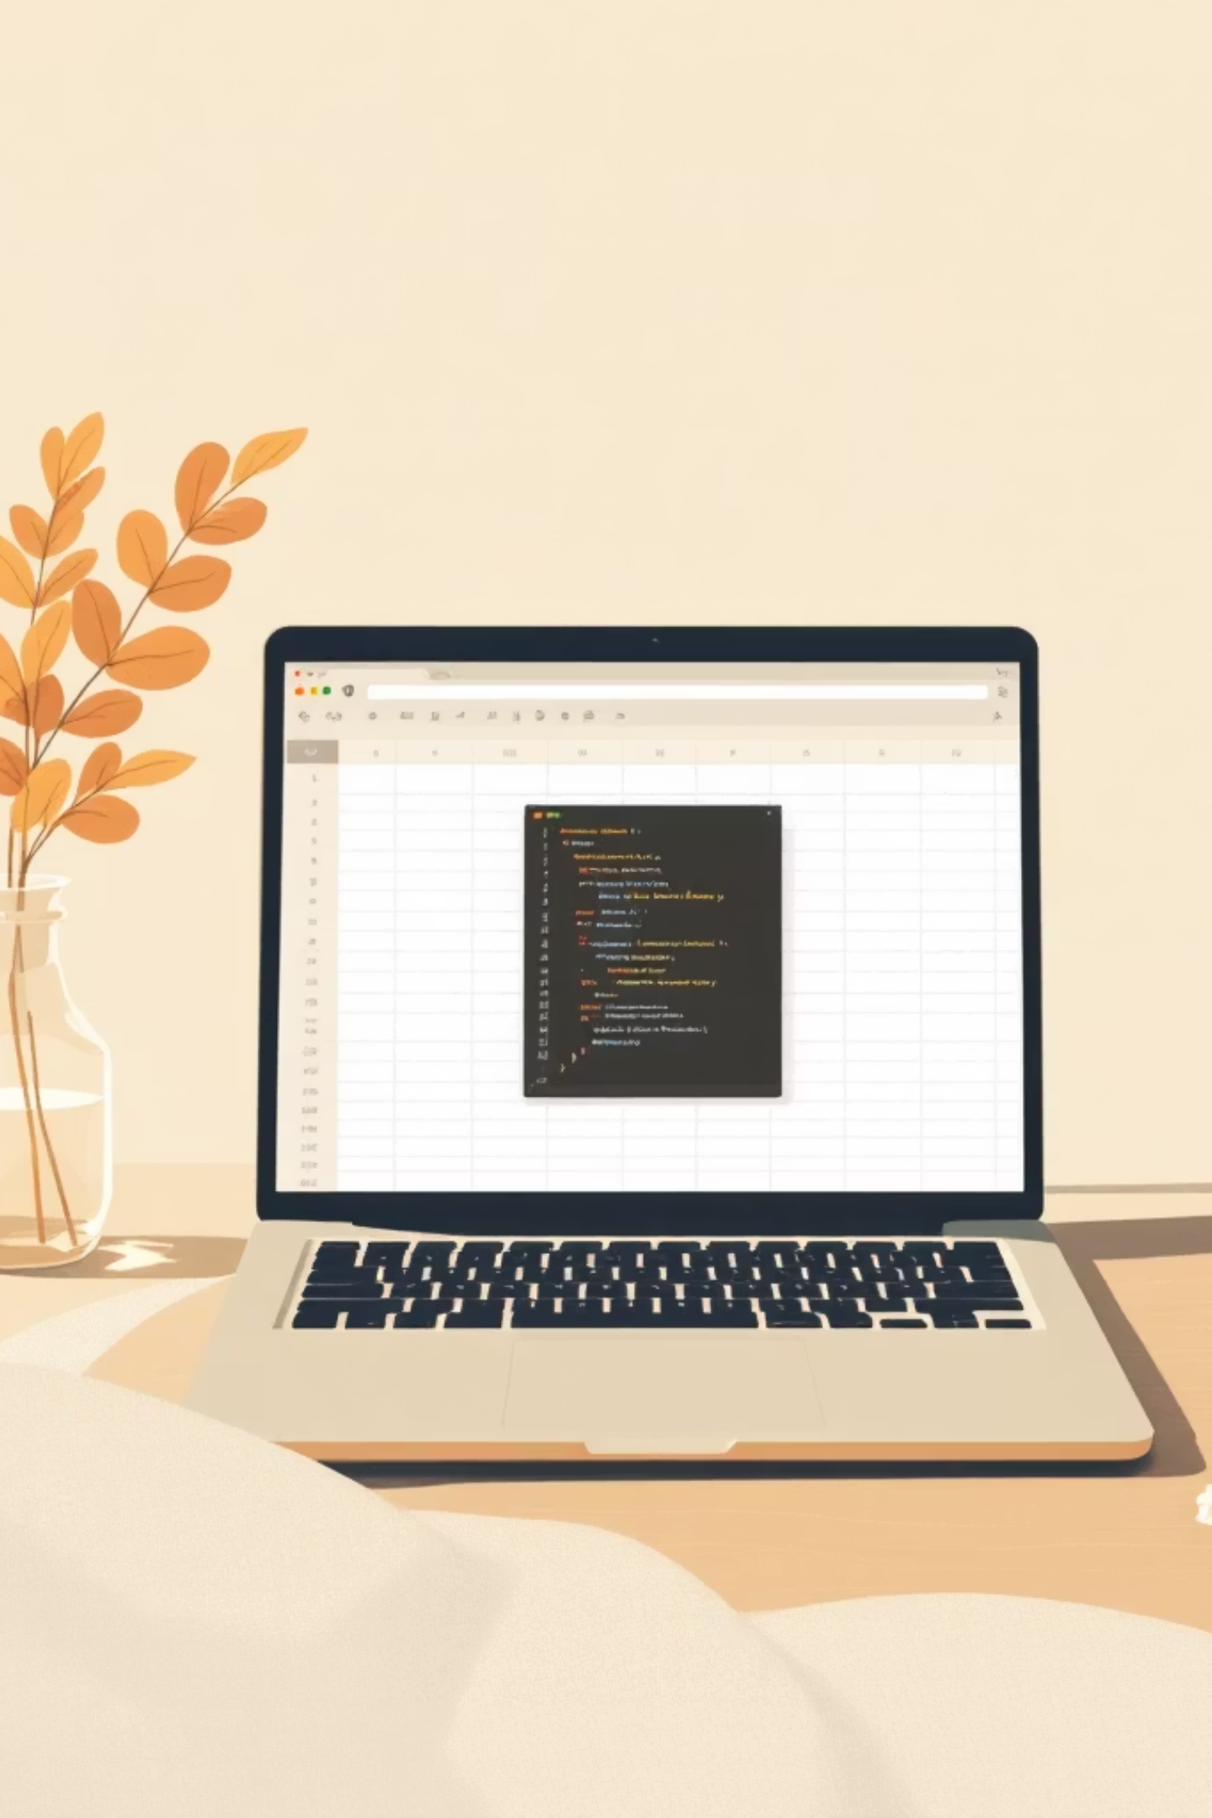
Dataset Summary
Size
Key Features
Missing Data
3,900 rows · 18 columns
Demographics, purchase details, behavior, subscription
37 missing Review Rating values

Slide 3
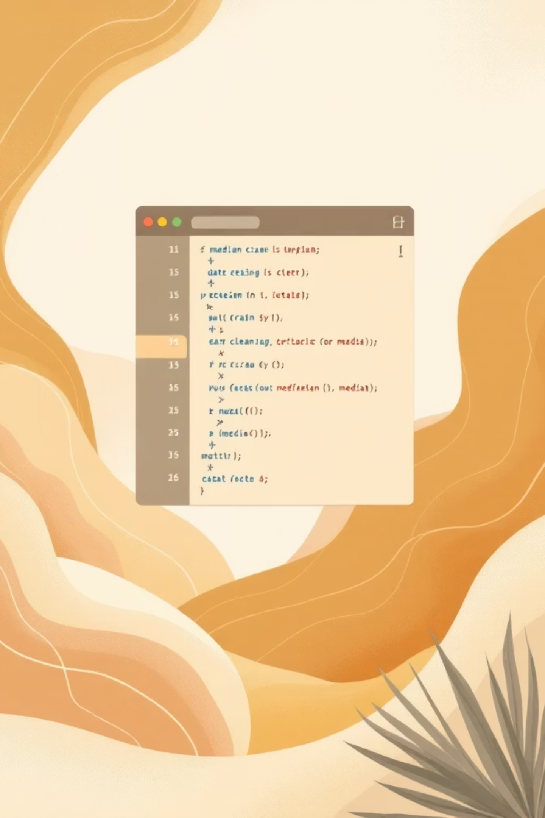

Data Preparation (Python)
Load & Inspect
pandas: df.info(), df.describe()
Missing Values
Imputed Review Rating by category median
Standardize
Renamed columns to snake_case
Feature Engineering
age_group, purchase_frequency_days

Slide 4
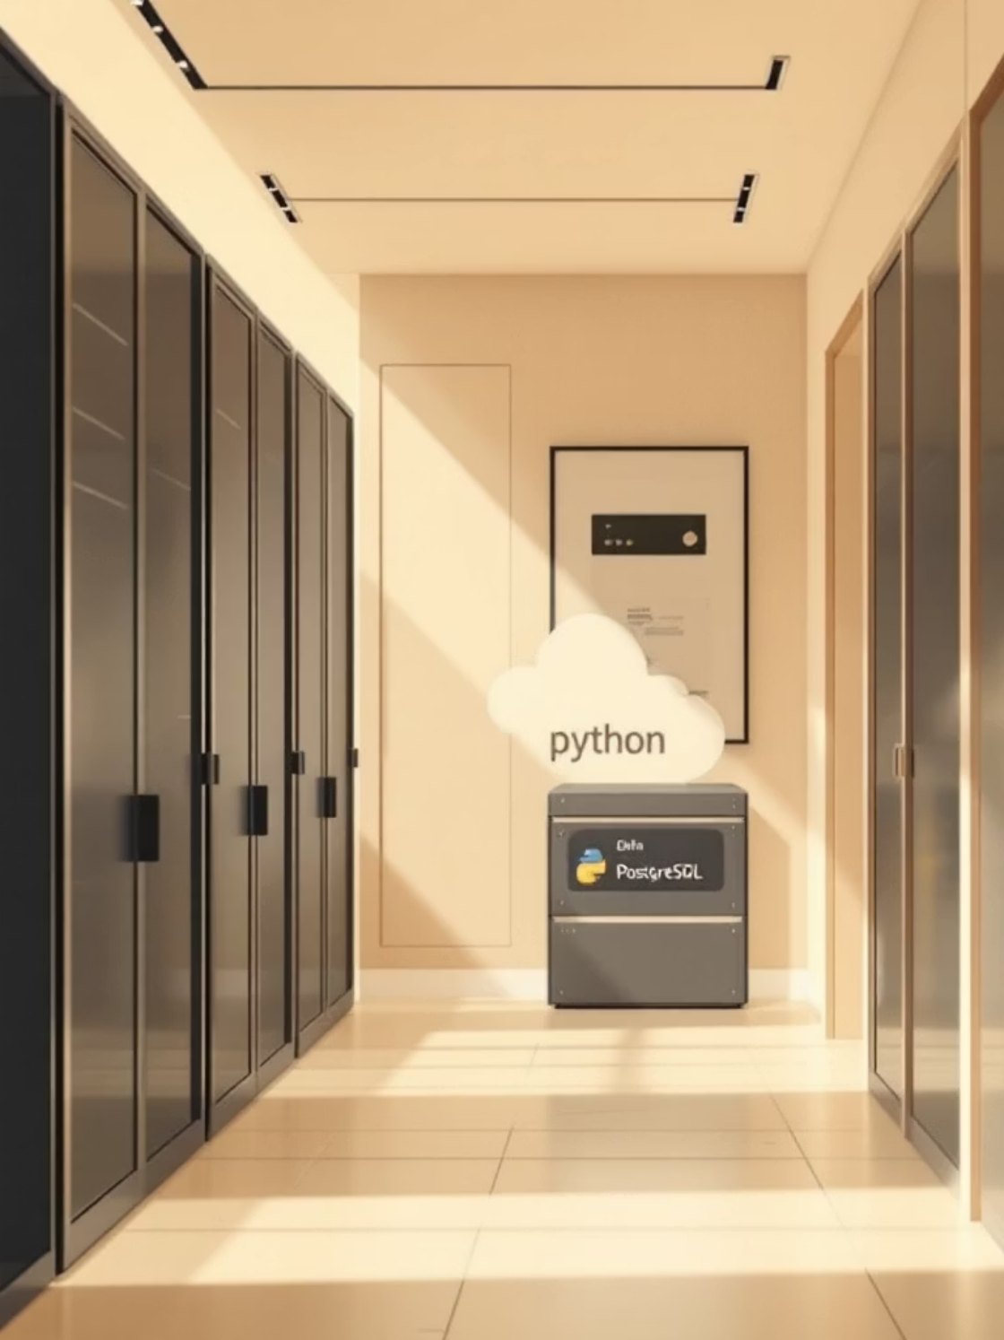
Database Integration & SQL
Cleaned DataFrame loaded to PostgreSQL for business queries and aggregations.
Why SQL?
Scalable joins, aggregation, production-ready queries

Slide 5
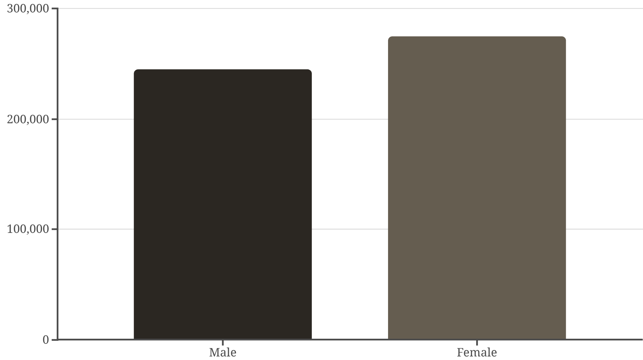
Revenue by Gender
Compare total revenue by gender to identify high-value groups.
Action: tailor campaigns by gender performance

Slide 6

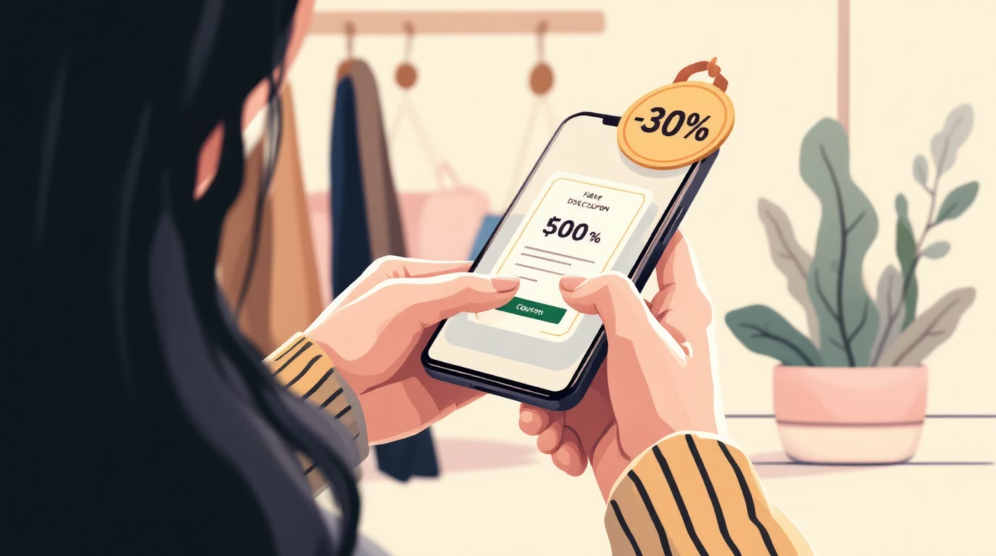
Discount Behavior & High Spenders
High-Spending Discount Users
Customers using discounts but spending above average
Discount-Dependent Products
Top 5 products with highest % discounted purchases
Recommendation: review discount policy to protect margins.

Slide 7

Customer Segmentation
Returning
New Customers
Loyal
Use segments for targeted retention and acquisition tactics.

Slide 8

Subscriptions & Repeat Buyers
Subscribers vs Non
Compare avg spend & total revenue
Repeat Buyers
Customers with >5 purchases more likely to subscribe
Recommendation: boost subscriptions with exclusive benefits.

Slide 9
Insights & Recommendations
Boost Subscriptions
Loyalty Programs
Review Discounts
Product Positioning
Reward repeat buyers to increase loyalty
Balance sales lift with margin control
Promote exclusive subscriber benefits
Feature top-rated & best-selling items
Targeted Marketing
Focus on high-revenue age groups & express-shipping users
Dashboard: interactive story for stakeholders in Power BI.

